Slide 1


Python Project on Virtual Assistant
Submitted To :
Mr. Mohit Chowdhary
Assistant Professor
CSE – AI
Submitted By :
Praveen Kumar
Prabhakar Yadav

Slide 2
Abstract
Making an interactive virtual assistant with various features such as delivering information regarding any person, playing YouTube songs/videos, telling date and time etc .

Slide 3
Introduction
What are virtual assistants?
A virtual assistant is a conversational agent that interacts with users using natural language.
Started as an attempt to fool humans.

Slide 4
Objective
Need for virtual assistants?
Widespread use of personal machines
Better Human Computer Interaction
“To express their interest, wishes, or queries directly and naturally, by speaking, typing, and pointing”.

Slide 5
You: Alexa what is current time
Alexa: Current time is 2:30PM
You: Alexa who is Narendra Modi
Alexa: Narendra Damodardas Modi (Gujarati: [ˈnəɾendɾə dɑmodəɾˈdɑs ˈmodiː] (audio speaker iconlisten); born 17 September 1950)[a] is an Indian politician serving as the 14th and current prime minister of India since 2014

Slide 6
Design & Implementation
Libraries used-
We used 6 python libraries to make our project -
speech_recognition: Library for performing speech recognition
pyttsx3: this is a text-to-speech conversion library in Python
pywhatkit: this library is used for sending WhatsApp messages, playing YouTube videos, google search etc.
datetime: this library gives date and time information
wikipedia: this library searches things on Wikipedia and give us the results
pyjokes: this library gives random jokes

Slide 7
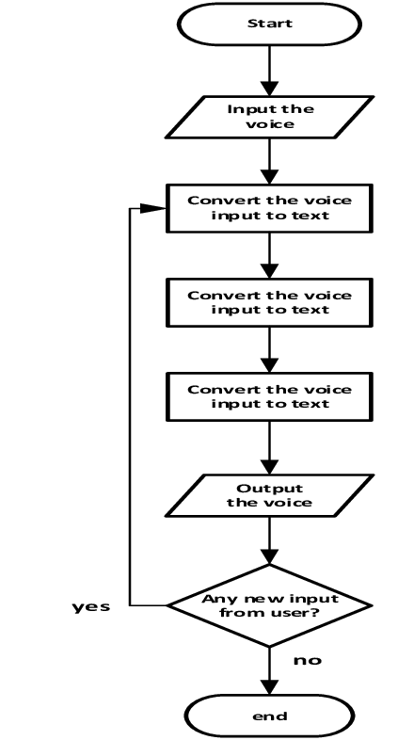

Slide 8
Structure of Program
We split our program into 3 functions-
run_alexa() : this function calls take_command() function to take command and perform task according to the input received
take_command(): this function takes voice command from the user and returns the command to run_alexa() function
talk(): this function uses text to speech library to convert the processed information into speech

Slide 9
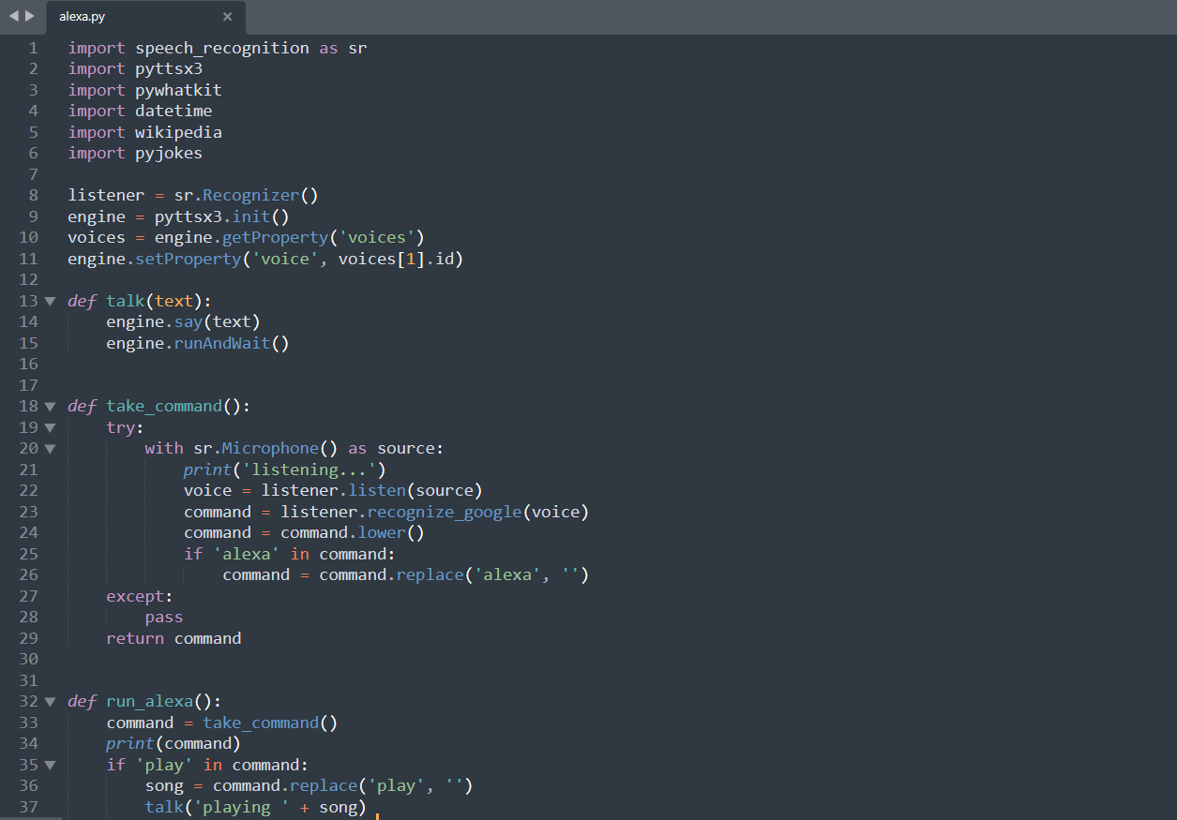
Code

Slide 10
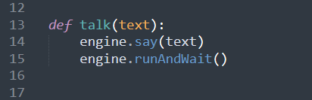
Functions
talk()
This function uses text to speech library to convert the processed information into speech
say() method will convert the text to speech
runAndWait() method will make the speech audible in the system

Slide 11
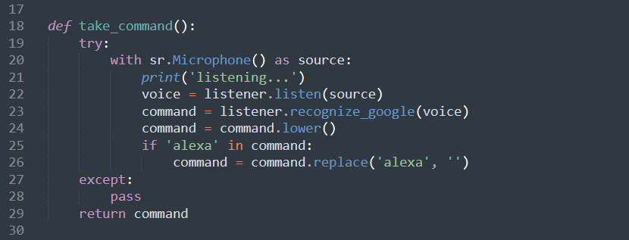
take_command()
This function takes voice command from the user converts it into text by google API and returns the command to run_alexa() function
listener is object of class recognizer from speech_recognition library
listen() method listens for the first phrase from default microphone and extract it into audio data
recognize_google() is google web speech API to convert speech into text (it requires internet connection)

Slide 12
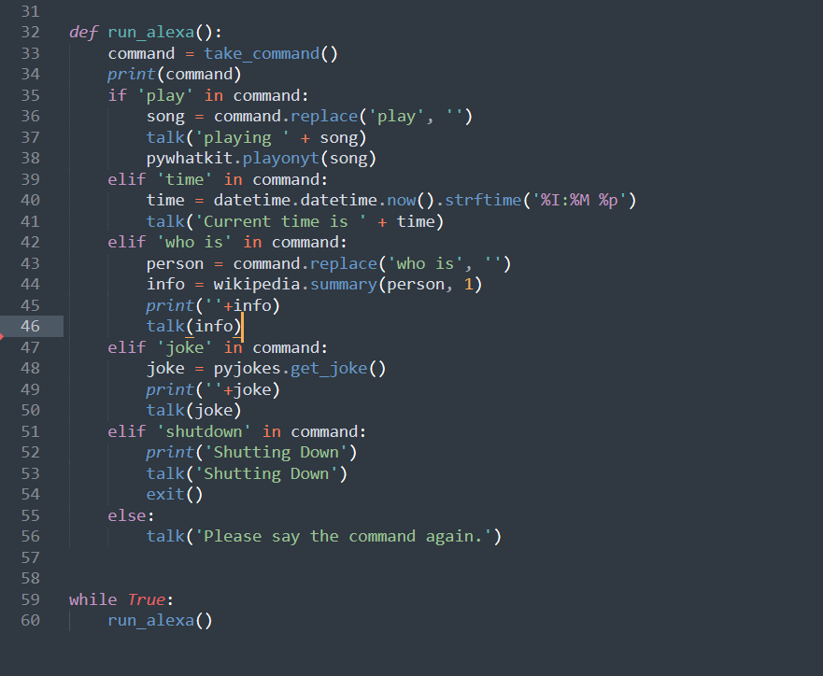
run_alexa()
This function calls take_command() function to take command and perform task according to the input received

Slide 13
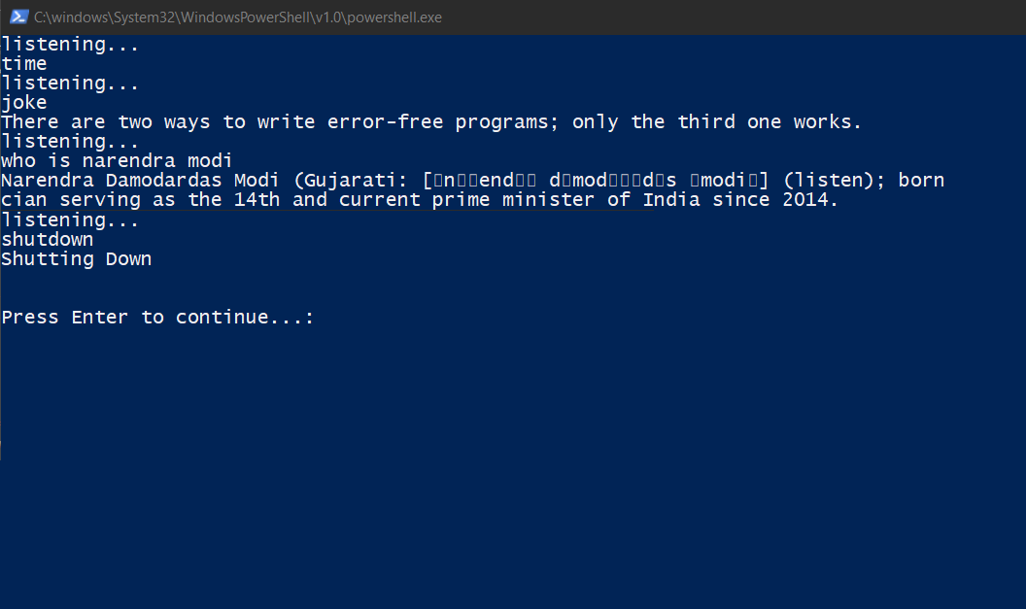
Result
Program interface

Slide 14
Summary
Virtual assistants are effective tools when it comes to assist humans through voice commands.
The aim of virtual assistant designers should be: to build tools that help people, facilitate their work, and their interaction with computers using natural language; but not to replace the human role totally, or imitate human conversation perfectly.

